Slide 1

Multi-Knapsack Problem using DP
Project Members:
Haneesha Damaraapati
Sai Ashrith Gaveni

Slide 2
Introduction
Knapsack Problem is used to define number of each item to include in a collection so that the total weight is less than or equal to a given capacity and the total profit is maximum.
Consider an inventory management system, where we need the number of containers required to ship from one place to another.
So, we considered another popular algorithm the Bin packing problem which considers the items of different weights and gives a solution of containers needed of C capacity and also looks for a way to minimize the number of bins.

Slide 3
Algorithm
Step 1: Consider the number of items t, weights w and their respective profits p. With those values profit-weight ratio for each item will be calculated.
Step-2: Now sort the items in descending order based on the derived ratio from previous step.
Step-3: Consider the product with highest ratio and insert it in a bin.
Step-4: Now deduct the capacity of bin by the weight of that product.
Step-5: Add the profit value of that product to the total profit.
Step-6: Print the total profit value and the number of bins required.

Slide 4
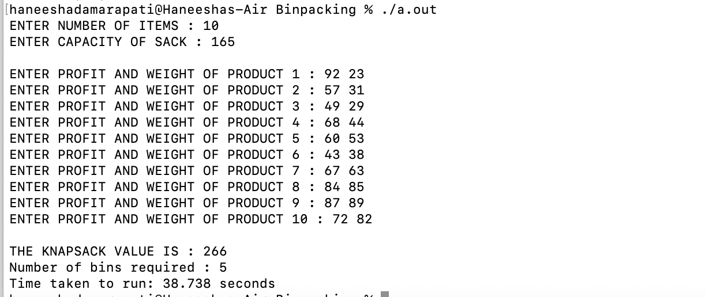
Output
Below is the output with Dataset
of 10 weights and profits for a
knapsack of capacity 165.
The weights of the objects
are 23,31, 29,44, 53, 38, 63, 85, 89, 82 .
The profits of each object
are 92, 57, 49, 68, 60, 43, 67, 84, 87, 72.

Slide 5
Perfomance

Slide 6


